Slide 1

🎓 Student Success Blueprint
Analyzing How Habits Shape Academic Performance
A Data Mining Project - Department of Computer Engineering
Presented by: Saurabh patil &
Yog garg
Roll No.: 23117033
& 23117041
Presented to:
. Dr. Jagdeep Kaur

Slide 2
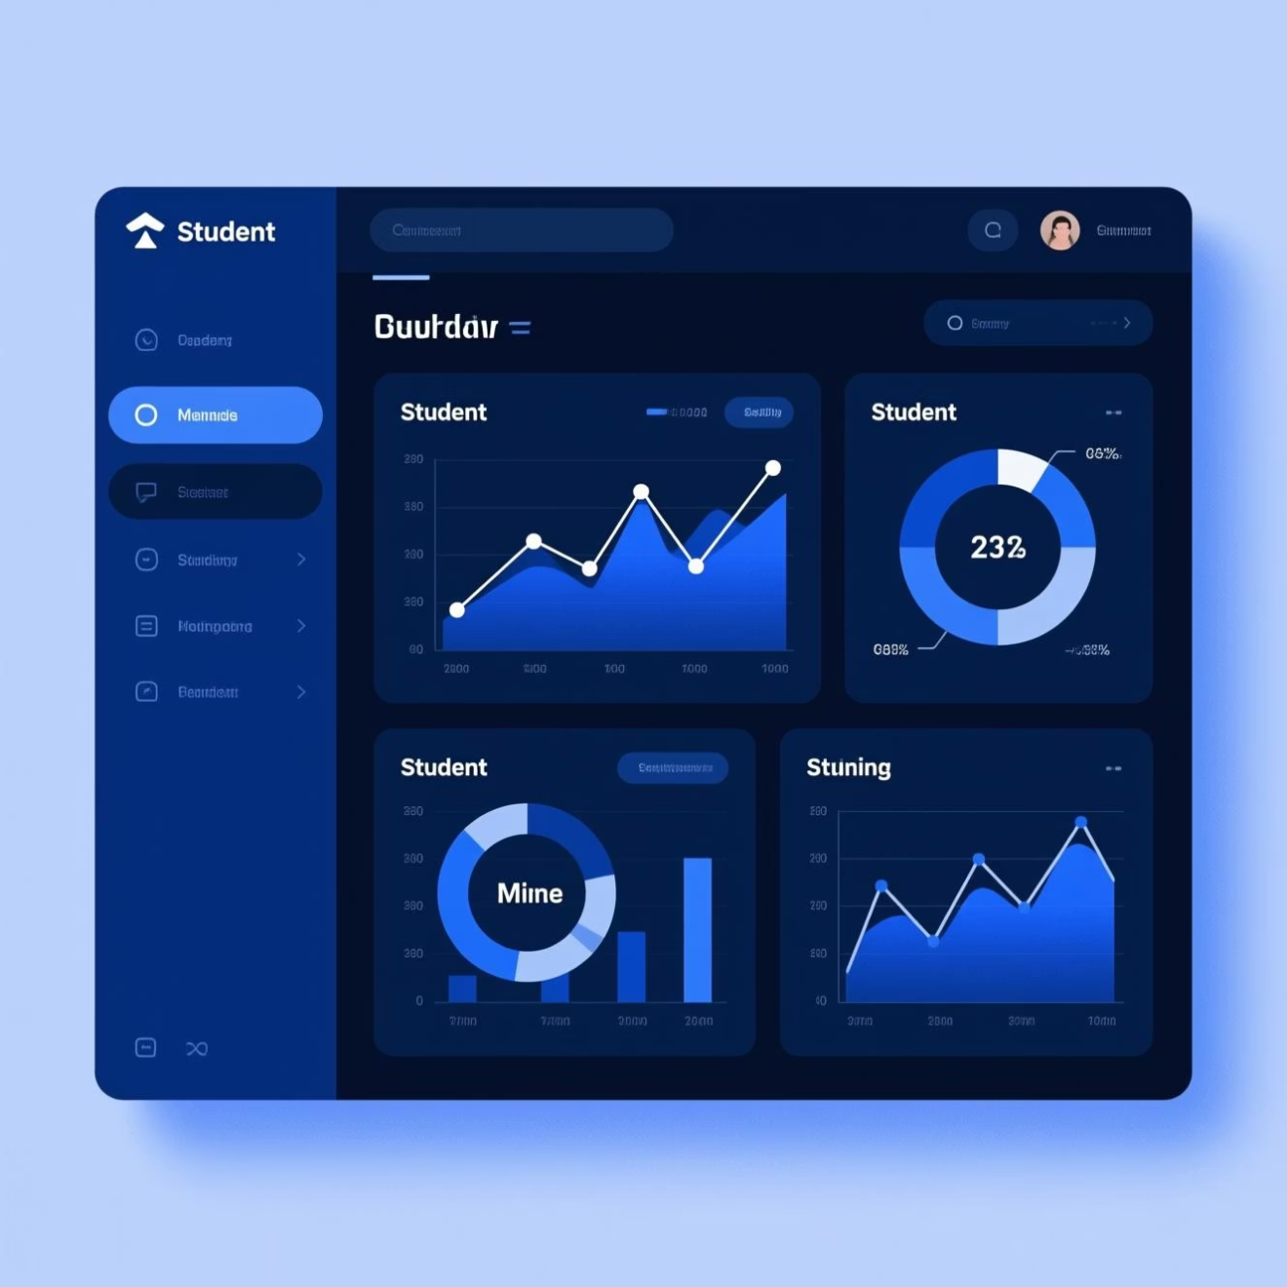
Project Overview: The Goal & Scope
This project utilizes real-world student data to build a predictive model for academic outcomes. Our aim is to move beyond simple correlation and establish actionable insights.
Identify GPA Patterns
Provide Success Insights
Analyze statistical relationships between study habits, lifestyle factors, and final grades (GPA).
Extract key behavioral drivers from the model to offer prescriptive guidance for students and educators.
.

Slide 3


The Dataset: Fueling Our Analysis
Our predictive power relies on a diverse dataset covering academic, social, and personal factors across 500+ undergraduate students.
1
2
3
Attributes Count
Student Cohort
Target Variable
Features cover 15 distinct factors, including screen time, attendance, study time, and extracurricular involvement.
Over 50 anonymized student records were analyzed, ensuring statistical significance and diversity.
The primary predicted output is the Final Semester GPA, categorized for classification modeling (High/Medium/Low).

Slide 4





Data Preprocessing Pipeline
Ensuring data quality is crucial. Our multi-stage pipeline transforms raw, heterogeneous student data into a clean, balanced, and model-ready format.
Raw Data Input
Initial collection of academic records and survey responses.
Cleaning & Imputation
Handling missing values, outlier detection, and data type correction.
Encoding Features
Converting categorical variables (e.g., branch, gender) into numerical representations (One-Hot Encoding).
Normalization
Scaling numerical features (e.g., study hours) to ensure uniform contribution to the model.
Balanced Data
Oversampling or Undersampling applied to address potential class imbalance in the target GPA categories.

Slide 5
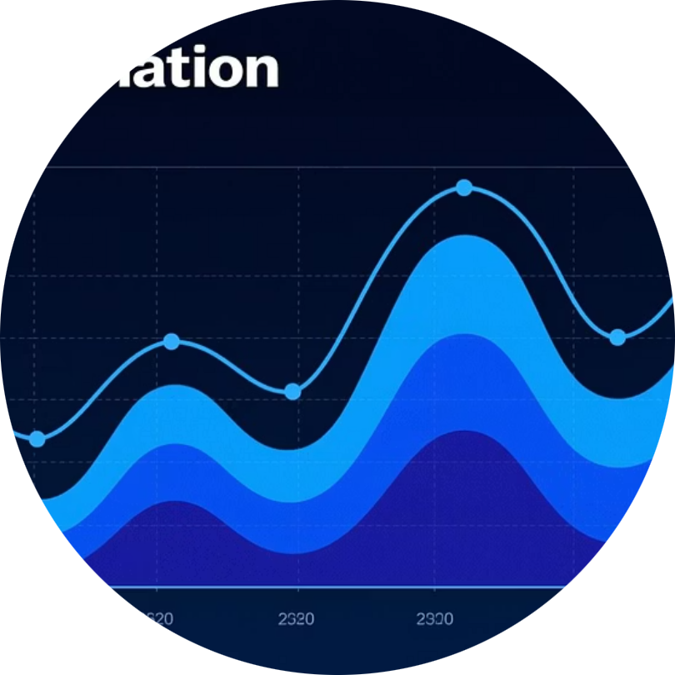
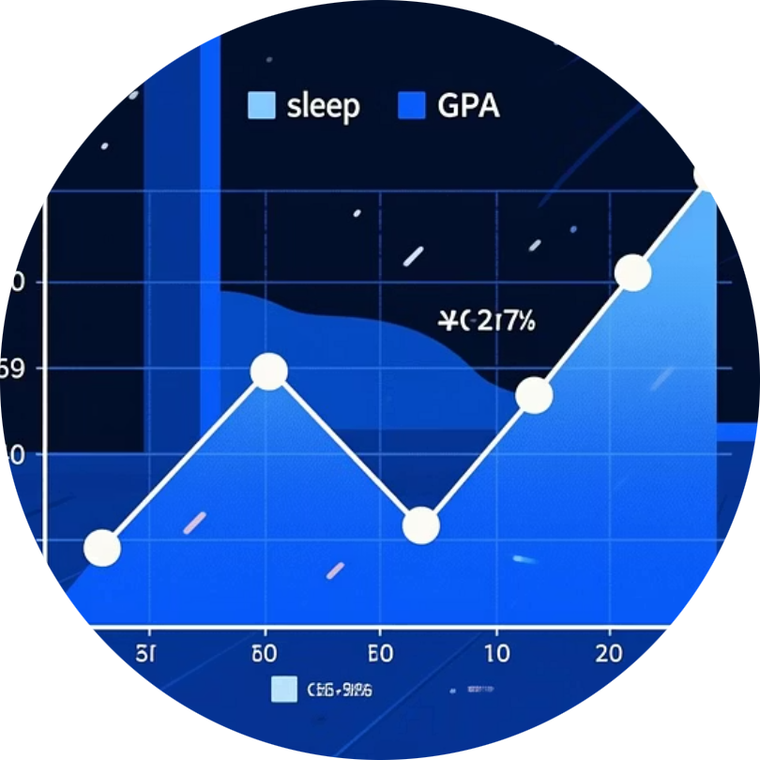
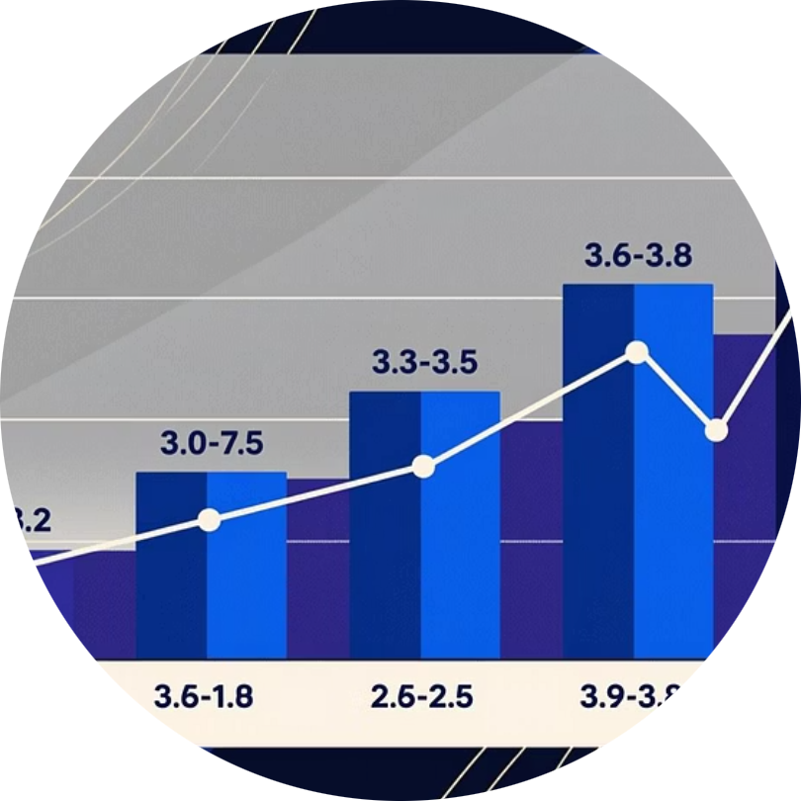
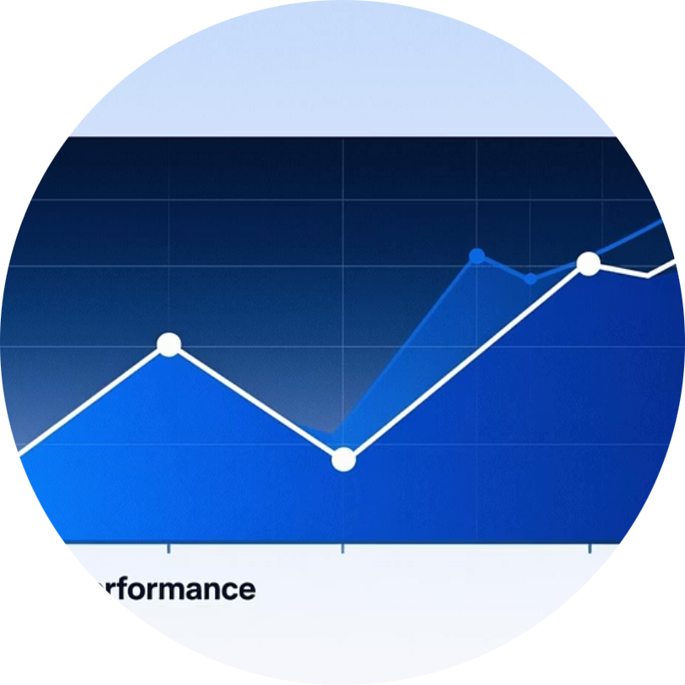
Key Visualization Insights
Exploratory Data Analysis revealed strong correlations and patterns, guiding our feature selection for the ML model.
Correlation Heatmap
Sleep vs GPA Analysis
Study Hours Trend
Stress Levels vs. Performance
Identified strong positive correlation between 'Study Hours' and 'Attendance' with GPA.
Students reporting 7-9 hours of sleep consistently showed higher mean GPAs than those with less than 6 hours.
The average weekly study time increases significantly for students in the highest GPA quartile.
A notable inverse relationship was found: high self-reported stress often correlates with declining GPA.

Slide 6
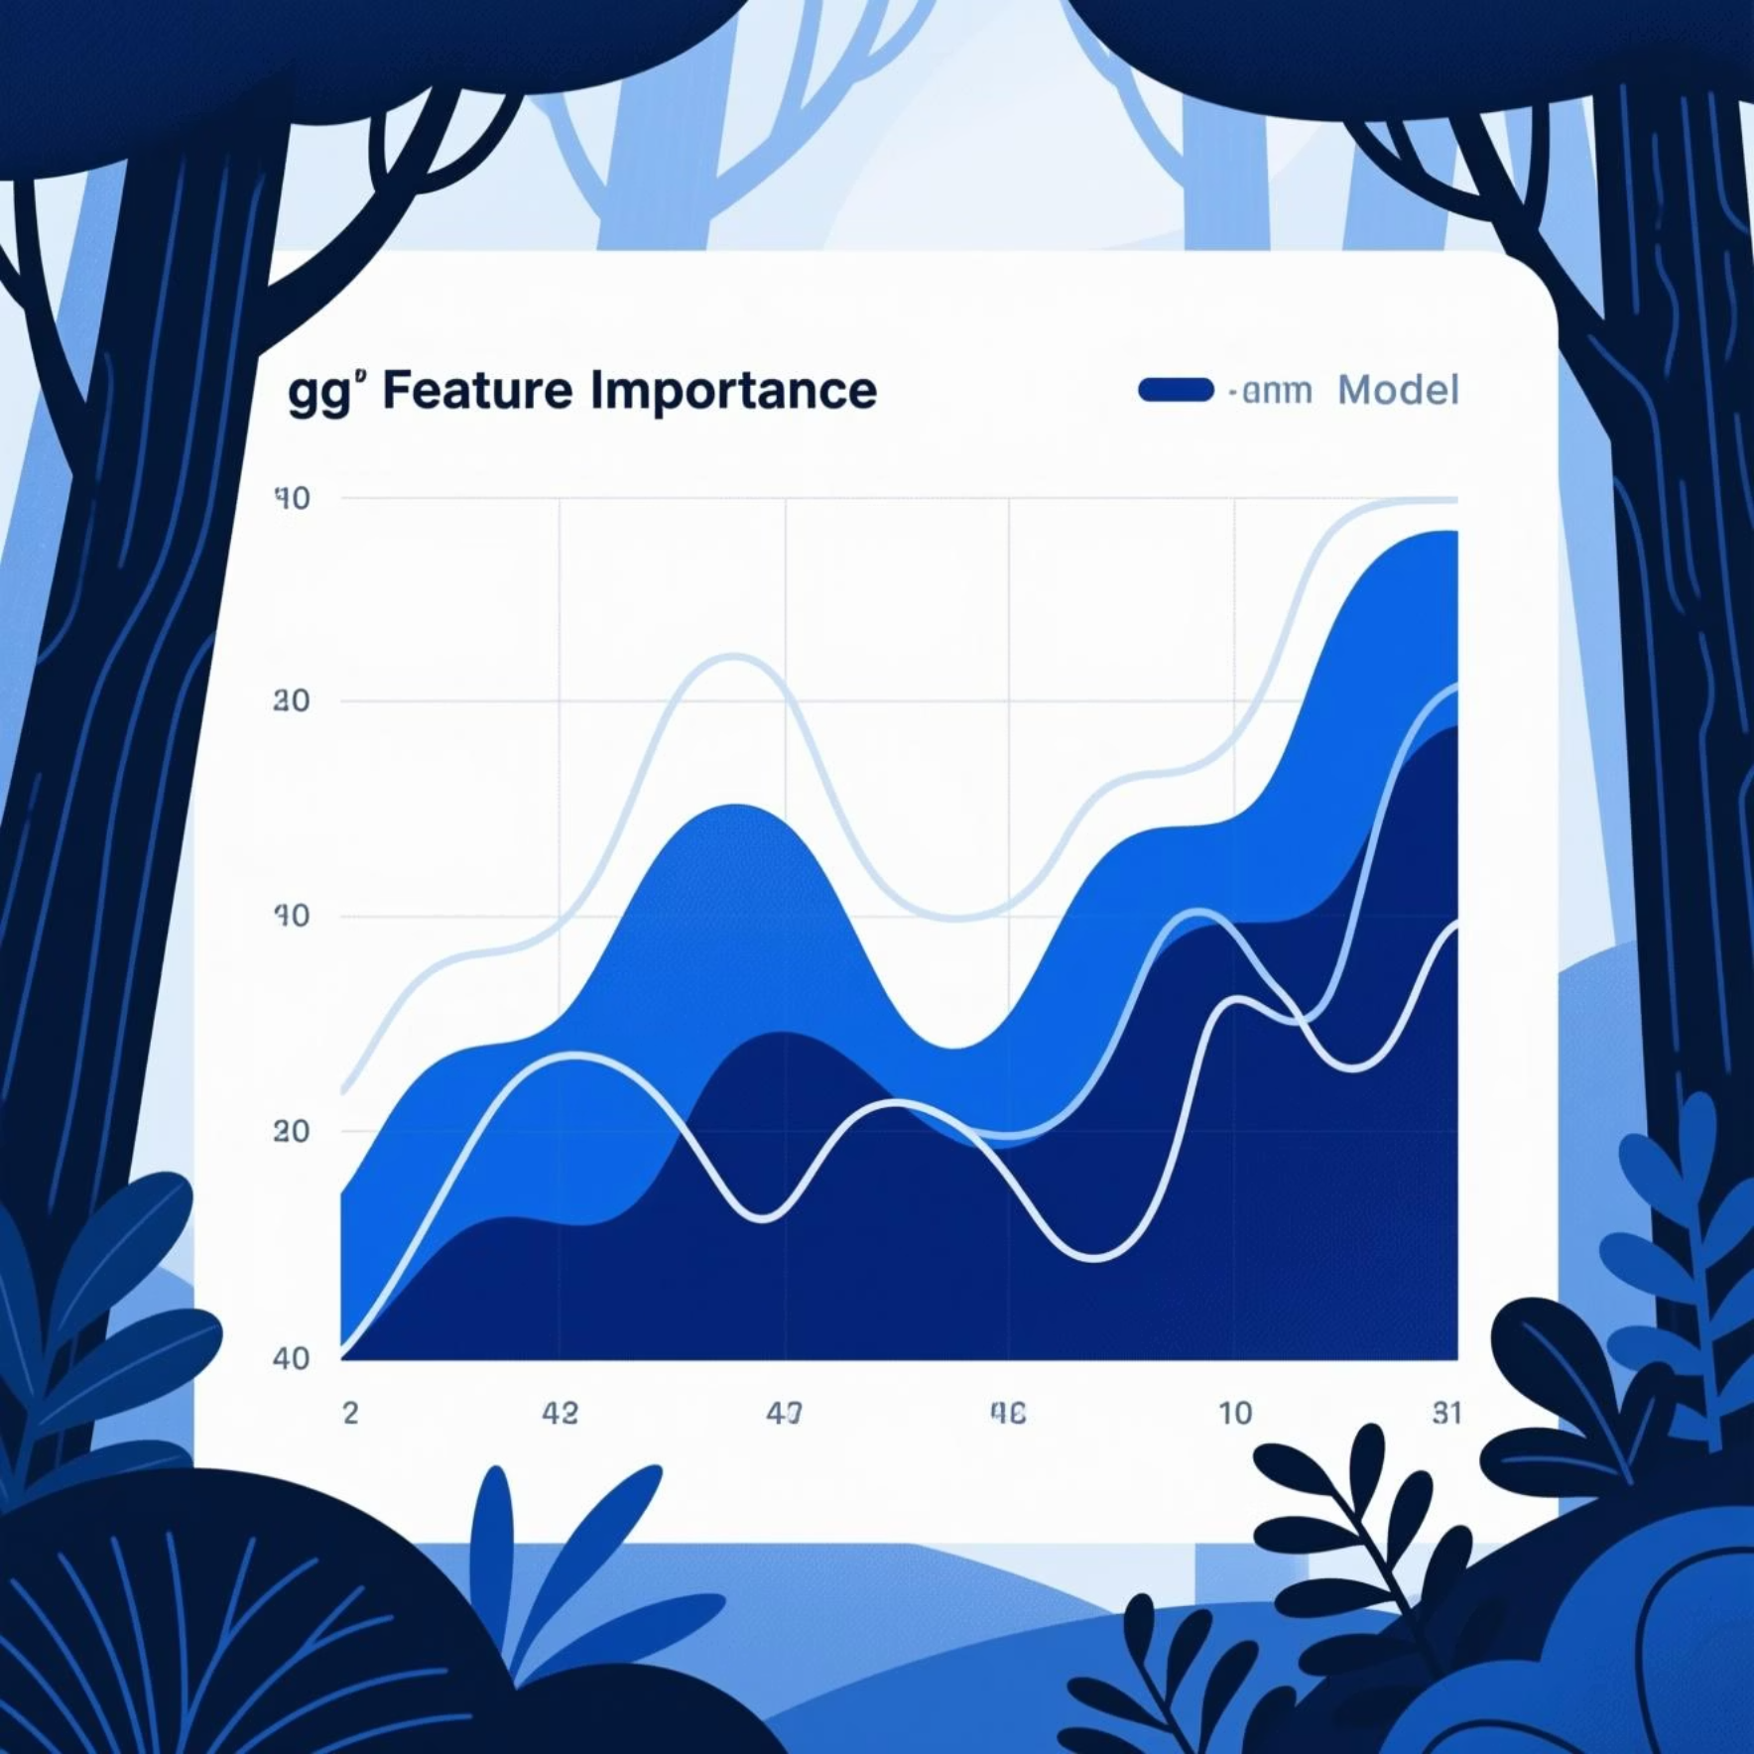
Important features
Input Features
Train/Test Split
Random Forest
Feature Importance
Predictions → 85-90%
The model prioritized these variables as the most significant predictors of GPA:
Weekly Dedicated Study Time
Class Attendance Rate
Quality of Sleep
Prior Academic Performance
Model Accuracy: ~88%

Slide 7










Actionable Findings: Decoding Success
The model validates several intuitive hypotheses while quantifying their impact, providing clear direction for student intervention programs.
Study Depth
Cognitive Load
Consistent, deep study sessions (not just volume) are the strongest predictor for high academic achievement.
Poor sleep dramatically reduces retention and problem-solving capabilities, impacting all subjects.
Stress Impact
Students with unmanaged stress levels consistently fall into lower GPA categories.
.
Presence Matters
High attendance directly correlates with higher engagement and better performance metrics across the board.

Slide 8
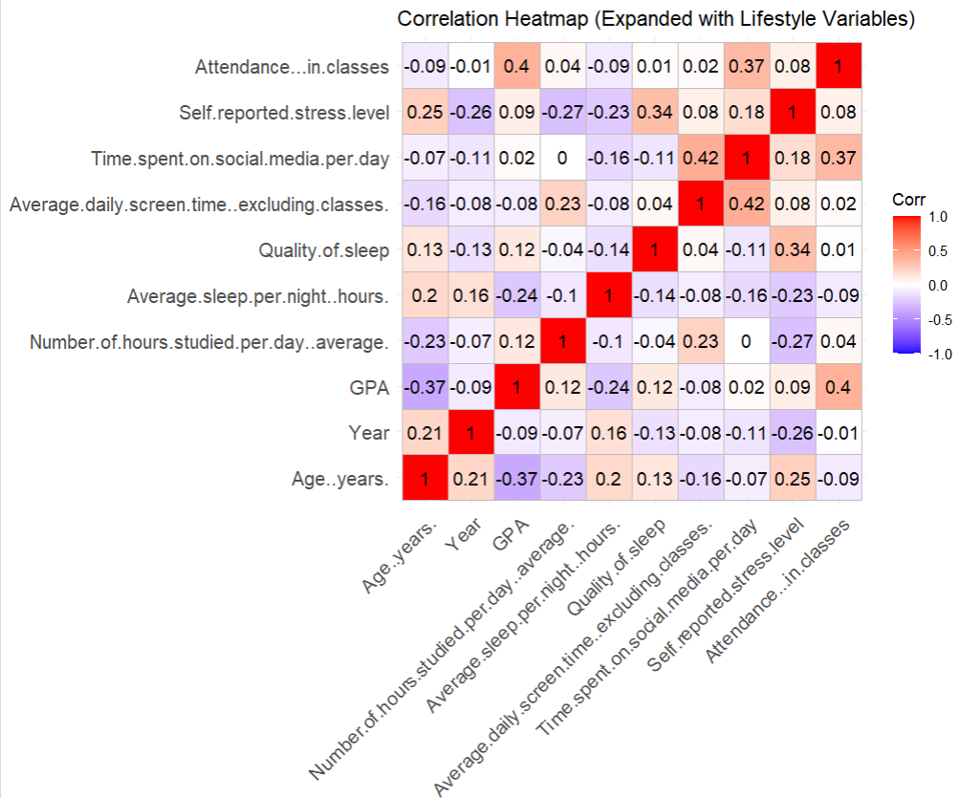

Conclusion & Future Direction
"Your habits today define your success tomorrow."
Key Takeaways
Academic success is quantifiable and highly dependent on non-academic factors.
Interventions should focus on sleep hygiene and stress management, alongside traditional study skills.
Machine learning provides reliable, data-driven pathways to enhance educational outcomes.

Slide 9




References and Tools
This project was made possible by leveraging powerful open-source tools and data from leading platforms.
R Language
Core platform for statistical computing and data analysis.
Tidyverse
Packages (dplyr, readr) used for efficient data manipulation and cleaning.
Kaggle
Source for initial anonymized student performance datasets.
ggplot2
Tool used for all high-quality data visualizations and plot exports.
Project created using R, tidyverse, randomForest, and ggplot2 for analysis and visualization.

Slide 10

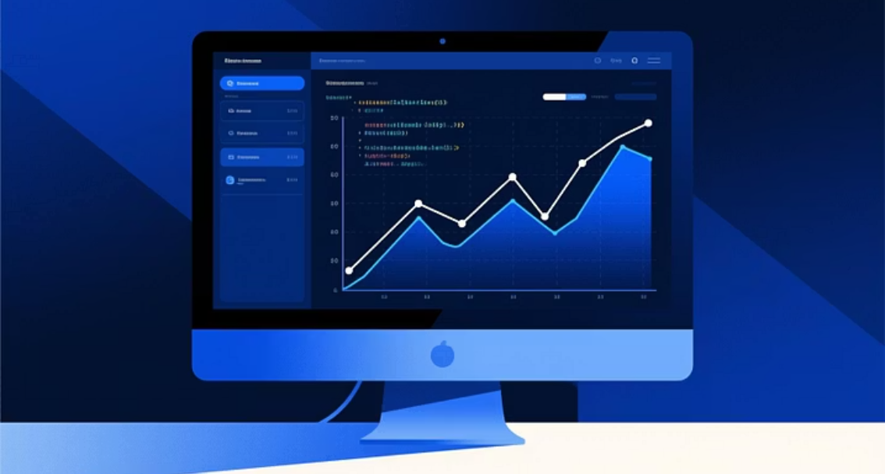

Thank You
Questions & Discussion
We welcome your feedback on the model's application and future potential.

